Slide 1
Chap#8
Marketing Plan

Slide 2
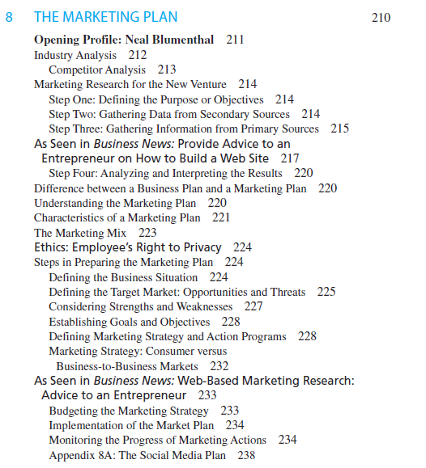
Content

Slide 3
INDUSTRY ANALYSIS
The primary focus of the industry analysis is to provide sufficient knowledge of the environment (market analysis) that can affect marketing strategy decision making.
It begins with the broadest-based assessment of environmental and industry trends. Then it proceeds to more local market environmental and industry trends, including competition.
More specific information on such variables as customer needs, competitive strengths and weaknesses, price, promotion, distribution, and product or service benefits.
This market research project may add important valuable insights that can assist the entrepreneur in determining the most effective market position, setting market goals and objectives, and determining what action programs are necessary to meet those goals and objectives.

Slide 4
Competitor Analysis
The entrepreneur should begin this step by first documenting the current strategy of each primary competitor.
Newspaper articles, Web sites, catalogs, promotions, interviews with distributors and customers, and any other marketing strategy or company information available should be reviewed.
These articles should be scanned for information on competitor strategies and should identify the names of individuals who were interviewed, referenced, or even mentioned in the article.
Entrepreneur should begin to identify the strengths and weaknesses of each competitor.
Notes:
Catalog: pamphlet or book containing details

Slide 5
MARKETING RESEARCH FOR THE NEW VENTURE
Marketing research involves the gathering of data to determine such information as who will buy the product or service, what is the size of the potential market, what price should be charged, what is the most appropriate distribution channel, and what is the most effective promotion strategy to inform and reach potential customers.
Marketing research may be conducted by the entrepreneur or by an external supplier or consultant.
Market research begins with a definition of objectives or purpose.
Step One: Defining the Purpose or Objectives
The most effective way to begin is for the entrepreneur to sit down and make a list of the information that will be needed to prepare the marketing plan.
one objective would be to ask people what they think of the product or service and whether they would buy it, and to collect some background and attitudes of these individuals.
Notes:
Venture: risk or adventure

Slide 6
Step Two: Gathering Data from Secondary Sources
Gathering information for the industry analysis
Magazines, newspaper articles, libraries, government agencies, and the Internet can provide much information on the industry market and competitors.
Assist the entrepreneur in making the best decisions regarding the marketing of a product or service.
Step Three: Gathering Information from Primary Sources
Gathering primary data involves a data collection procedure—such as observation, networking, interviewing, focus groups, or experimentation—and usually a data collection instrument, such as a questionnaire.
Table 8.3
Step Four: Analyzing and Interpreting the Results
Entrepreneur may want to compare the results to questions by different age groups, sex, occupation, and location. Then data can be cross-tabulated to provide more focused results.

Slide 7
DIFFERENCE BETWEEN A BUSINESS PLAN AND A MARKETING PLAN
The marketing plan focuses on all marketing activities of a venture for one year or more. The marketing plan will vary significantly for a firm depending on the industry, target market, and the size and scope of the organization. It is an integral part of a business plan.
The business plan is the road map for the entire organization over time. It focuses on not just marketing issues but also such decisions as research and development, operations, manufacturing, personnel, financial projections and analysis, and future growth strategies. It also should be updated on a regular basis to help the management stay focused and meet organization goals.

Slide 8
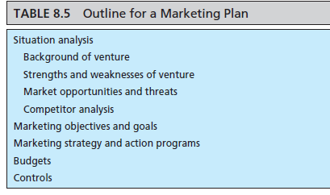
UNDERSTANDING THE MARKETING PLAN

Slide 9
CHARACTERISTICS OF A MARKETING PLAN
provide a strategy for accomplishing the company mission or goal.
provide for the use of existing resources. Allocation of all equipment, financial resources, and human resources must be described.
organization must be described to implement the marketing plan
successfully meeting longer-term goals and objectives
It should be simple and short describing details
Changes, if necessary, should be incorporated
Specify performance criteria that will be monitored and controlled.
major internal variables of marketing system are Financial resources, Management team, Suppliers, Company mission (fig 8.1)
Notes:
marketing plan Written statement of marketing objectives, strategies, and activities to be followed in business plan.
marketing system Interacting internal and external factors that affect venture’s ability to provide goods and services to meet customer needs
marketing mix Combination of product,price, promotion, and distribution and other marketing activities needed to meet marketing objectives

Slide 10
STEPS IN PREPARING THE MARKETING PLAN
Defining the Business Situation
The situation analysis is a review of where we have been. It also considers many of the factors that were defined in both the environmental analysis and the industry analysis.
Entrepreneur should provide a review of past performance of the product and the company.
If this is a new venture, the background will be more personal, describing how the product or service was developed and why it was developed (e.g., to satisfy consumer needs).
If the plan is being written after the new venture has started up, it would contain information on present market conditions and performance of the company’s goods and services.
Any future opportunities or prospects should also be included in this section of the plan.
Entrepreneur should simply review some of the key elements of this section to help provide a context for the marketing segmentation and actions that will be stated in this business plan.
Notes:
Situation analysis: Describes past and present business achievements of new venture

Slide 11
Continue…
Defining the Target Market: Opportunities and Threats
Entrepreneur should have a good idea of who the customer or target market will be. Knowledge of the target market provides a basis for determining the appropriate marketing action strategy that will effectively meet its needs.
Market segmentation is the process of dividing the market into small homogeneous groups. Market segmentation allows the entrepreneur to more effectively respond to the needs of more homogeneous consumers.
Figure 8.2
The process of segmenting and targeting customers by the entrepreneur should proceed as follows:
I. Decide what general market you wish to pursue.
II. Divide the market into smaller groups based on characteristics of the customer or buying situations.
A. Characteristics of the customer
1. Geographic (e.g., state, country, city, region)
2. Demographic (e.g., age, sex, occupation, education, income, and race)
3. Psychographic (e.g., personality and lifestyle)
B. Buying situation
1. Desired benefits (e.g., product features)
2. Usage (e.g., rate of use)
3. Buying conditions (e.g., time available and product purpose)
4. Awareness of buying intention (e.g., familiarity of product and willingness to buy)
III. Select segment or segments to target.
IV. Develop a marketing plan integrating product, price, distribution, and promotion.

Slide 12
Continue…
Considering Strengths and Weaknesses
It is important for the entrepreneur to consider strengths and weaknesses in the target market.
A lack of understanding of the culture and differences in consumer buying habits could be critical in any attempt to reach these markets.
Establishing Goals and Objectives
Entrepreneur must establish realistic and specific goals and objectives.It should specify things such as market share, profits, sales by region, market penetration(in depth), number of distributors, awareness level, new product launching, pricing policy, sales promotion, and advertising support.
It is a good idea to limit the number of goals or objectives to between six and eight.Too many goals make control and monitoring difficult. Obviously, these goals should represent key areas to ensure marketing success.

Slide 13
Continue…
Defining Marketing Strategy and Action Programs
Entrepreneur can begin to develop the marketing strategy and action plan to achieve them. These decisions reflect on the marketing mix variables.
Product or Service: This element of the marketing indicates a description of the product or service to be marketed in the new venture. This product or service definition may consider more than the physical characteristics.Marketed with direct-marketing and Internet techniques promising quick delivery and low prices. It involves packaging, the brand name, price, warranty, image, service, delivery time, features, style.
Pricing: Prior to setting the price, the entrepreneur, in the majority of situations, will need to consider three important elements: costs, margin(limit to gain), and competition. There are some exceptions, which are discussed at the end of this section on pricing. Also explained is the interaction of these elements in the pricing process.
Distribution:This factor provides utility to the consumer; that is, it makes a product convenient to purchase when it is needed. This variable must also be consistent with other marketing mix variables. Thus, a high-quality product will not only carry a high price but should also be distributed in outlets that have a quality image.(Table 8.8)
Promotion: It is usually necessary for the entrepreneur to inform potential consumers about the product’s availability or to educate the consumer, using advertising media such as print, radio, television, social media, and electronic media.
Notes:
marketing strategy and action plan Specific activities outlined to meet the venture’s business plan goals and objectives

Slide 14
Marketing Strategy: Consumer versus Business-to-Business Markets
Marketing strategy decisions for a consumer product may be very different from the decisions for a business-to-business product. In business-to-business markets, the entrepreneur sells the product or service to another business that uses the product or service as part of its operations.
In marketing to consumers, the company uses direct mail and the Internet, and to businesses it uses its own sales force. Advertising and promotion for the business-to-business market involve more trade magazine advertising, direct sales, and trade shows.Techniques and strategies within the mix of these factors will often vary significantly.

Slide 15
Budgeting the Marketing Strategy
Effective planning decisions must also consider the costs involved in the implementation of these decisions.
If the entrepreneur has followed the procedure of detailing the strategy and action programs to meet the desired goals and objectives, costs should be reasonably clear. If assumptions are necessary, they should be clearly stated so that anyone else who reviews the written marketing plan will understand these implications.
This budgeting of marketing action and strategy decisions will also be useful in preparing the financial plan.

Slide 16
Implementation of the Market Plan
The marketing plan is meant to be a commitment by the entrepreneur to a specific strategy.
It is not a formality that serves as a superficial document to outside financial supporters or suppliers.Commitment to make adjustments as needed or dictated by market conditions. Someone in the venture should be assigned the responsibility of coordinating and implementing the plan.

Slide 17
Monitoring the Progress of Marketing Actions
Generally, monitoring of the plan involves tracking specific results of the marketing effort.
Sales data by product, territory, sales rep, and outlet(location) are a few of the specific results that should be monitored.
What is monitored is dependent on the specific goals and objectives outlined earlier in the marketing plan.
Any “weak” signals from the monitoring process will provide the entrepreneur with the opportunity to redirect or modify the existing marketing effort to allow the firm to achieve its initial goals and objectives.
In addition to monitoring the progress of the existing plan, the entrepreneur should also be prepared for contingencies(condition).

